Slide 1
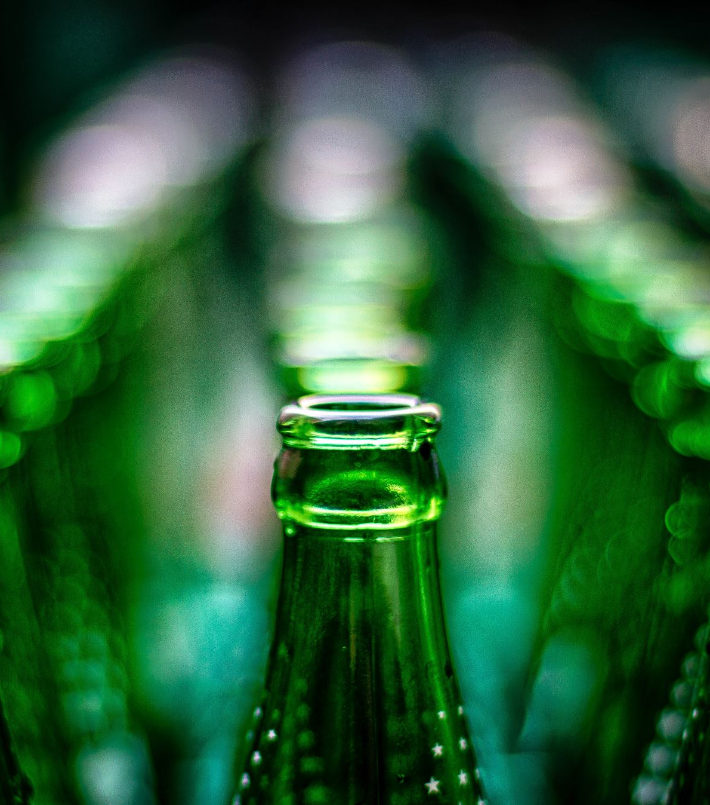

Beer Case Study
Submitted By -
Shreya Johari

Slide 2
Problem Statement
Analyse and find insights for the given data which comprises of different parameters to review Beers based on -
Beer ABV
Beer Brewery
Review Rating based on different parameters like aroma, taste etc
Review in Written Text by different users and the time of the Review

Slide 3
Potential Business Problems
The business wants various insights based on the data given.
Some of the insights Business needs are -
Top 3 Breweries which produces the strongest beer.
Based on the user's ratings which factors are important among the taste, aroma, appearance and palette.
Which beers seems to be favorite based on the reviews written by the users.
How does written review compare to overall review score for the beer styles.
How do we find similar beer drinkers by using written reviews only.

Slide 4

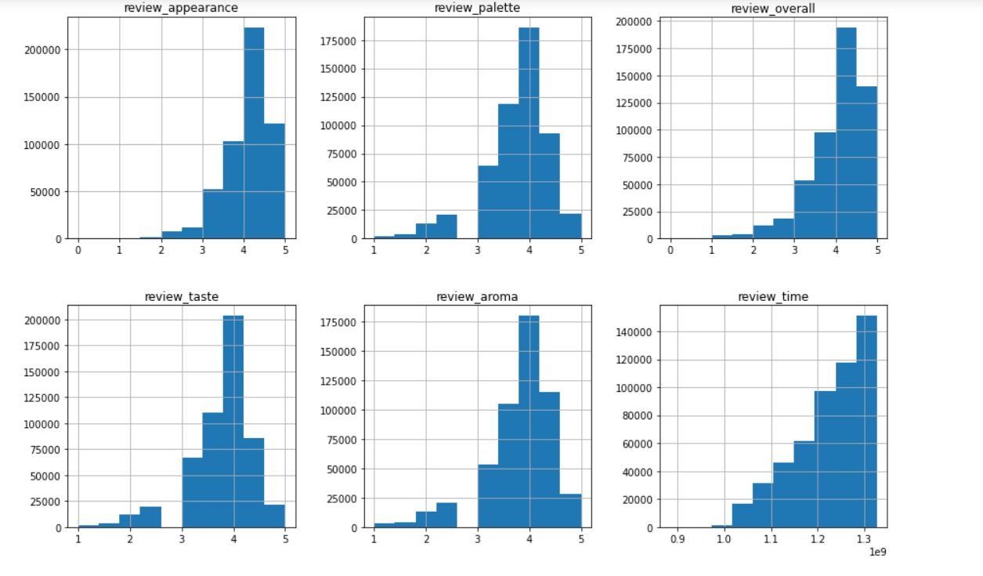
Data Analysis
Histogram for different types of reviews for beer.

Slide 5
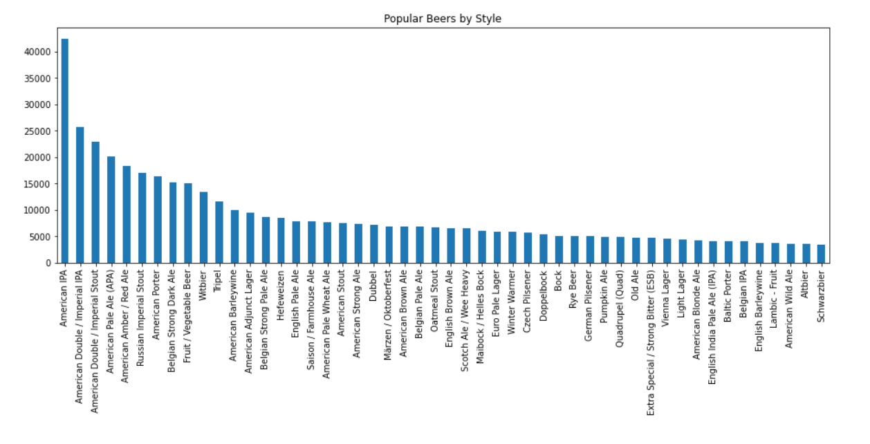
Bar Chart for Popular Beers

Slide 6
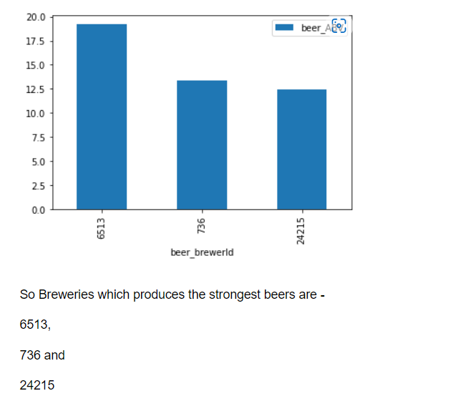
Top 3 Breweries which produces strongest beers

Slide 7
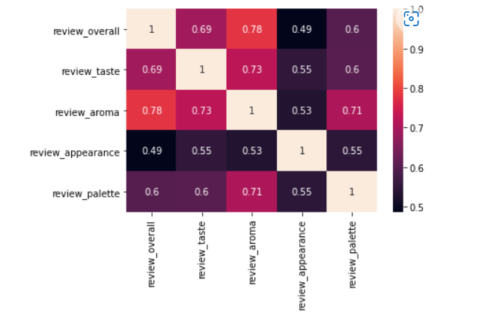
Correlation Between Overall Rating and Other Ratings

Slide 8

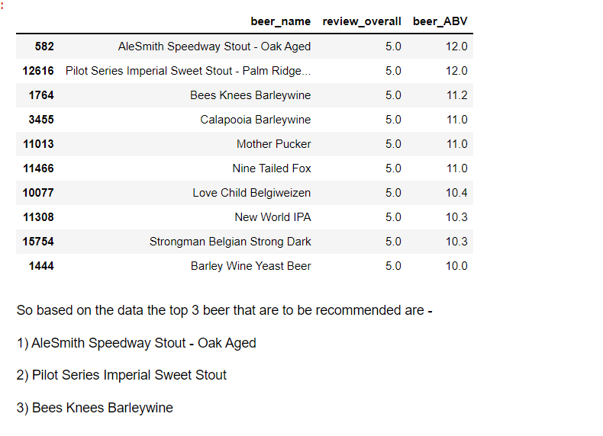
Top 3 Beers
Top 3 Beers that can be Recommended

Slide 9
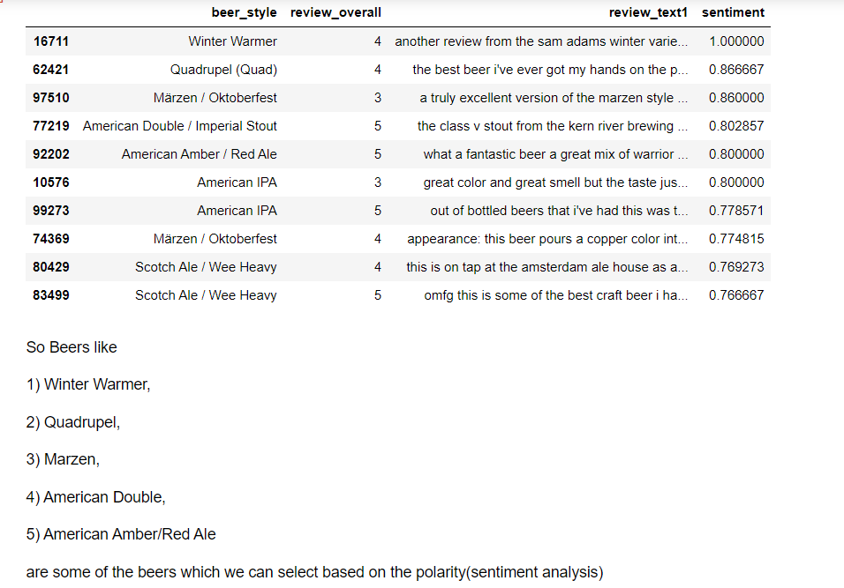
Some Beers Selected based on Review Text and Polarity

Slide 10
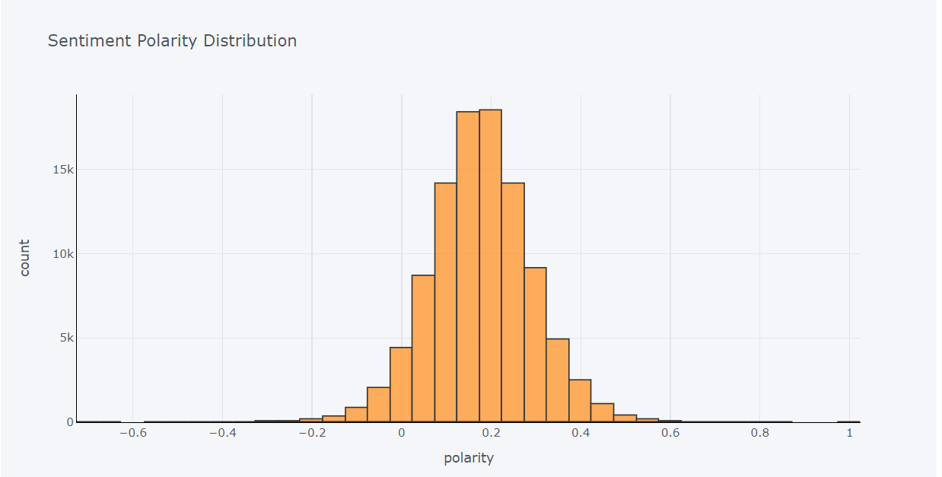
Sentiment Polarity Distribution

Slide 11
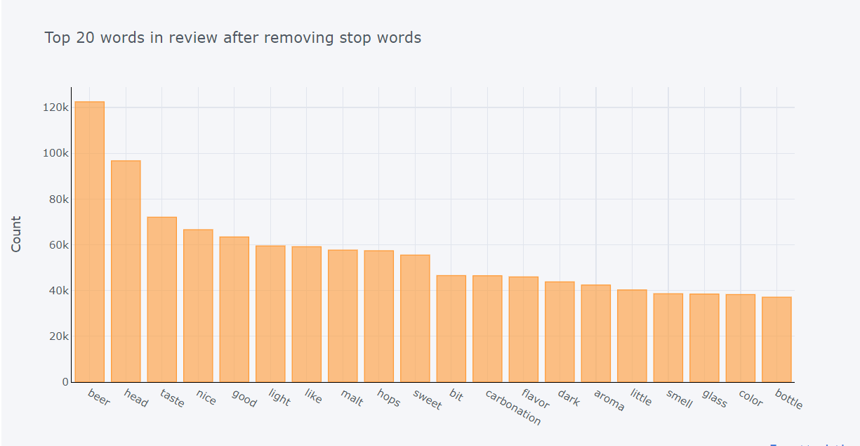
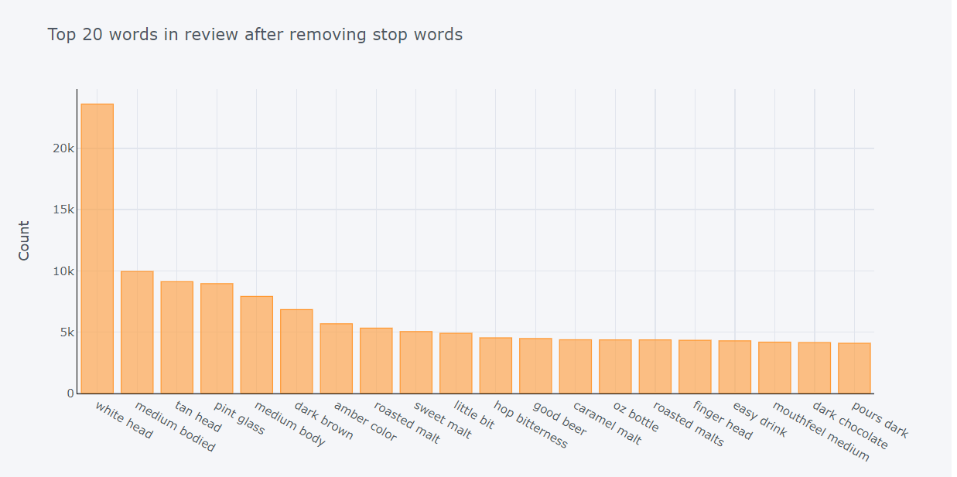
Top 20 Words from Review Texts

Slide 12
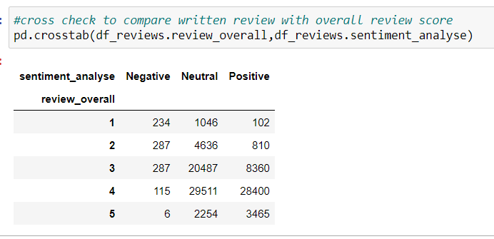
Comparing Written Review with Overall Review Score

Slide 13
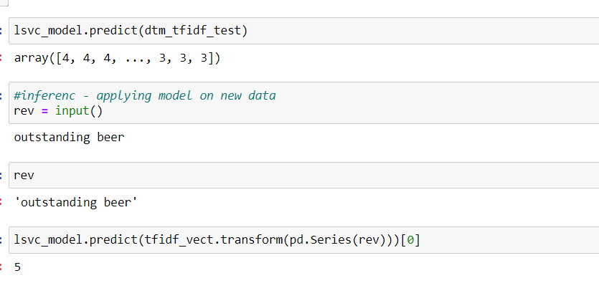
Model Results for Predicting Rating based on Review

Slide 14
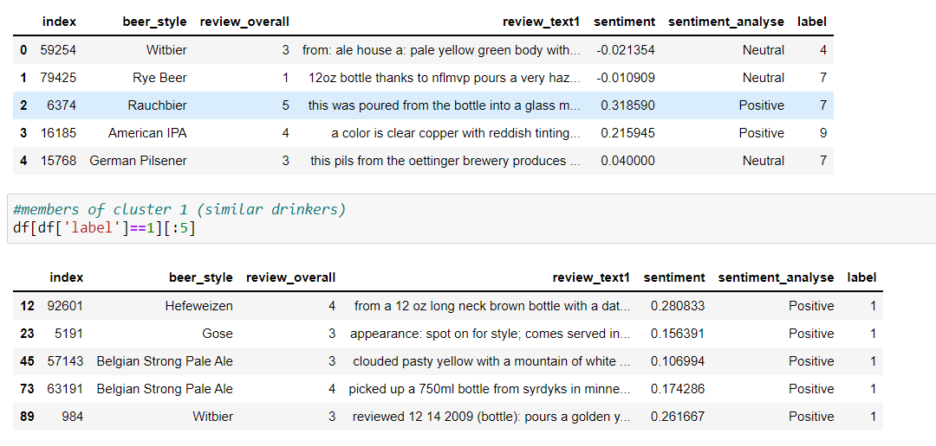
Clustering
Using Clustering for finding similar beer drinkers by using written reviews.

